Slide 1
The Code – once done, the scoresheet can be “read” to recreate the game.
Always record everything in the position of the current server (even if the receiving team takes a timeout or subs).
As soon as the ball is served (not before, not after the rally) draw the appropriate shape ( for a regular player, for a libero). If the libero serves, put another triangle around the service order number she serves in.
Fill in the result of the rally in the empty shape once the play is over
A number if the point was won by the serving team
An R if the receiving team wins the rally (a ”side out”)
A P if a replay is issued
Write a P when a re-serve is granted when the server tosses the ball and lets it drop/catches it.
When the receiving team wins the point put the point they received from the side out in a .
Always mark the running total column in the middle of the sheet with the same shape the point is in from the in-line portion of the scoresheet.
If a team takes a time out, write a T. If the receiving team takes a time-out (which it usually is) write Tx (x means the other team). Then, at the middle and bottom of the scoresheet, on the side of the team that took the timeout, write their score first-other team’s score second.
If a team subs, write S (or Sx) followed by a fraction of then cross out the player and write the new player in the service order and mark off a sub for the appropriate team.
Switch colors after going through all 6 service orders for each team.
$${player \# in}/{player \# out}$$

Slide 2
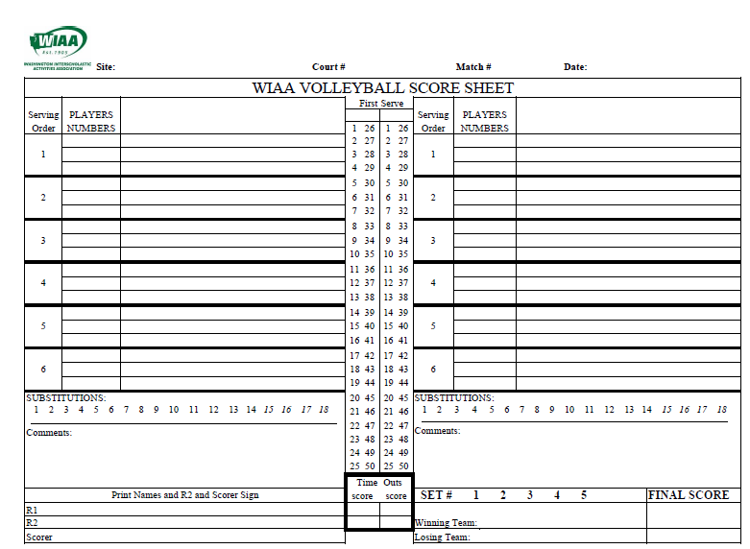
Bright Future
Main
JV
Sep 17, 202x
Twilight Stars
X
Bright Future
2
1
R
23
24
25
1
1
2
R
18
19
20
21
22
T
R
4
2
3
4
R
3
3
4
5
P
Tx
R
Sx 14/8
6c
5
6
P
7
R
5c
6
R
14
8
8
9
10
11
12
13
R
8
7
7
8
9
10
11
R
10
Tx
9
Sx 8/14
R
14
15
16
17
R
13
12
S 13/9
12
18
19
20
21
22
23
M
R
11
13
14
15
16
17
R
YC #3 Set 1
23
YC Head Coach – USP – 12-18
YUD 0-0
RUD 17-11
Romin Referree
Sunny Day
1-5
12-17
Twilight Stars 25
Sunny Day
Your Name
22-22
Bright Future 22
Your Name

Slide 3
Bright Future
Main
JV
Sep 17, 202x
Twilight Stars
X
Bright Future
2
1
R
23
24
25
1
1
2
R
18
19
20
21
22
T
R
4
2
3
4
R
3
3
4
5
P
Tx
R
Sx 14/8
6c
5
6
P
7
R
5c
6
R
14
8
8
9
10
11
12
13
R
8
7
7
8
9
10
11
R
10
Tx
9
Sx 8/14
R
14
15
16
17
R
13
12
S 13/9
12
18
19
20
21
22
23
M
R
11
13
14
15
16
17
R
19
20
21
22
YC #3 Set 1
23
YC Head Coach – USP – 12-18
YUD 0-0
RUD 17-11
Romin Referree
Sunny Day
1-5
12-17
Twilight Stars 25
Sunny Day
Your Name
22-22
Bright Future 22
Your Name

Slide 4
Unless you are at a tournament, put which gym the match is being played in here – Main, Aux, Annex, etc
Unless you’re at a tournament, put the level of the game here. This is NOT the set number!
Twilight stars received their first point from a side out – this point goes in a square.
Put an X in the column of the team who serves first.
Switch to a new color the second time a server comes up (so you can still tell where you are in the order).
Bright Future
Main
JV
Sep 17, 202x
In the center column, put the same shape around the number.
Twilight Stars
X
Bright Future
After the serving team took a timeout, the scorer and referees realize the wrong server has been serving. All points get canceled and a side out occurs (in a square because there wasn’t a serve associated).
After 6’s first serve, she tossed for her second and let it drop. This is notated with a P inside a square (because she never contacted the ball, there is no circle).
2
1
R
23
24
25
1
1
2
R
18
19
20
21
22
T
R
4
2
3
4
R
3
3
4
5
P
Tx
R
Sx 14/8
Bright Future #1 served first. She served 3 times (there are 3 circles). The first two resulted in points, so the point is written in the circle. The third time resulted in a side out, so an R goes in the circle.
6c
5
6
P
7
R
5c
6
R
After awarding the 23rd point to TS, the R1 changes his mind. Cross out the original, write an M, then write the new result in a square. Cross out the point in the running column and rewrite the number next to it to use later.
14
8
8
9
10
11
12
13
R
8
7
7
8
9
10
11
R
A P in a circle means something happened that resulted in a replay. After play was stopped, TS took a time out, then subbed in 14 for 8 (the “x” says the receiving team did these things).
For subs, make sure to change the number in the service order and cross off a substitution.
10
Tx
9
Sx 8/14
R
14
15
16
17
R
13
12
S 13/9
12
18
19
20
21
22
23
M
R
11
13
14
15
16
17
R
19
20
21
22
Player #3 got a yellow card in the first set. This carries over, so gets notated on each set after.
The only thing about the libero on the scoresheet is if they serve. When they do, triangle the position, and use triangles instead of circles for each serve.
YC #3 Set 1
23
YC Head Coach – USP – 12-18
YUD 0-0
The head coach received a yellow card for unsporting conduct (“USP”). The score at the time it was received is written.
RUD 17-11
The coach turned in their lineup card late and got an unnecessary delay. Later they came out of a time out late and received a second delay, which was red and caused a side out (in a square because there wasn’t a serve associated).
Romin Referree
Sunny Day
1-5
12-17
Twilight Stars 25
Sunny Day
Your Name
22-22
Bright Future 22
This is where you indicate which set it is.
Your Name
Get both referees’ names and fill them in.
Make sure to sign the scoresheet and get the R2 to sign the scoresheet each set.
When time outs are taken, put a T or Tx inline on the sheet, then write the score here with the team who took the timeout’s score first.
After the set, fill in each team on the appropriate line, with their score in the final score boxes on the same line.

Slide 5
X

